Slide 1
Digital methods and tools
Cao Hoang Long
Vrije Universiteit Brussel
(University of Brussels)
Dec 2020

Slide 2
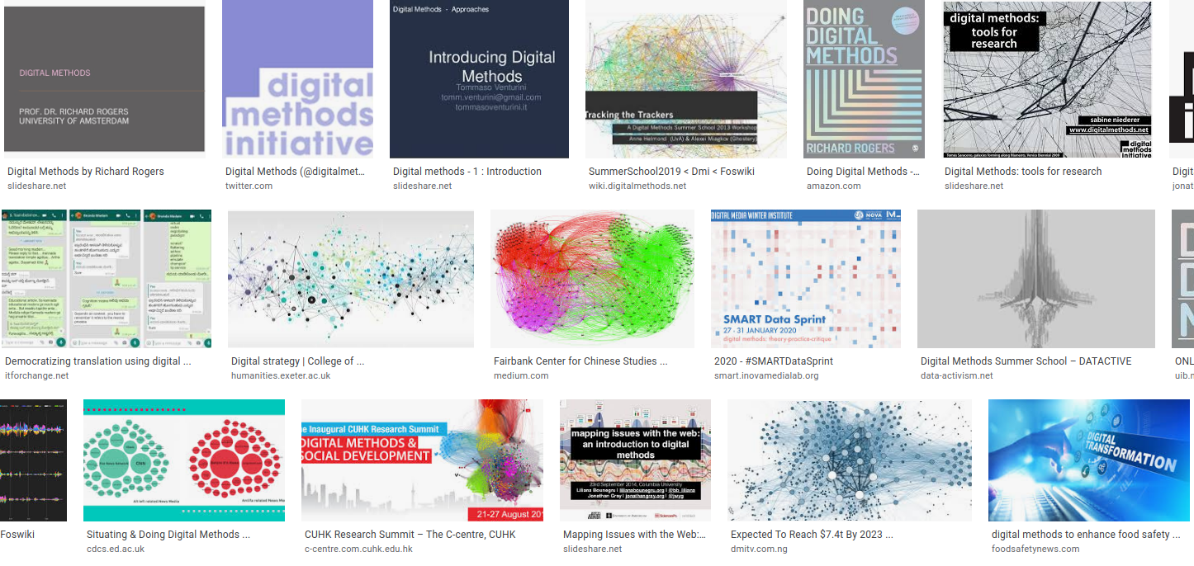
How to use digital methods and tools in reseach and...
google.com

Slide 3
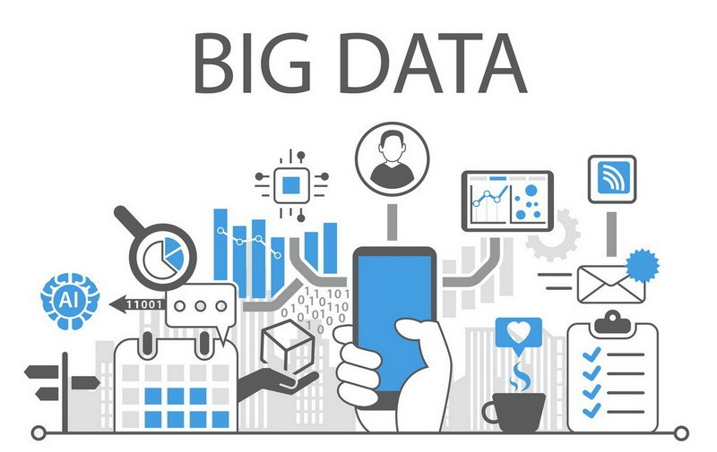
Lecture 1
...a lot of data
towardsdatascience.com

Slide 4
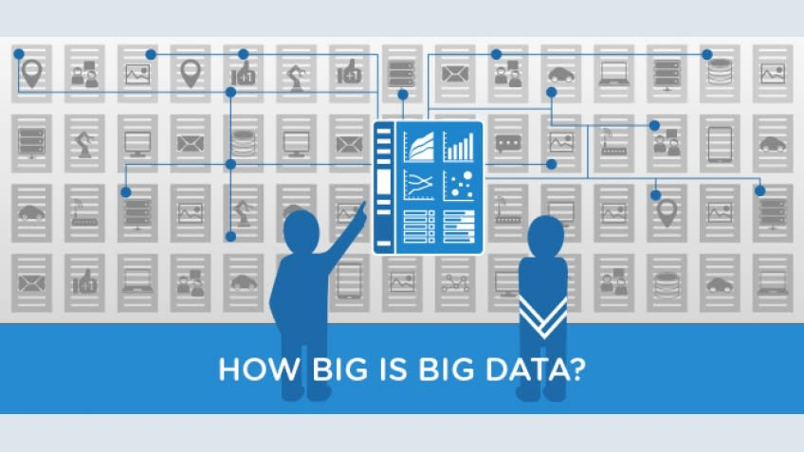
simplilearn.com
Notes:
Open question - to discuss with students - it’s a relative term.

Slide 5
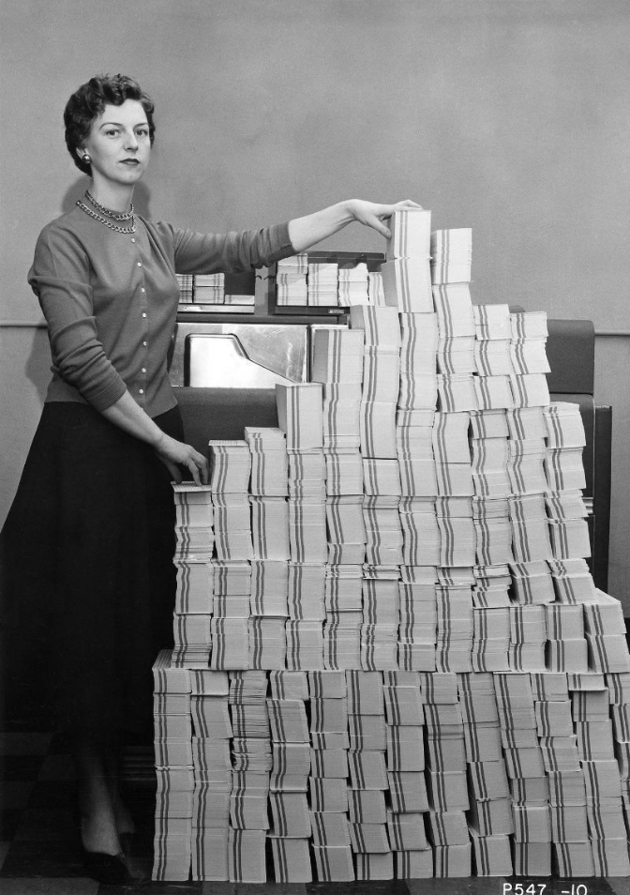
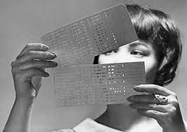
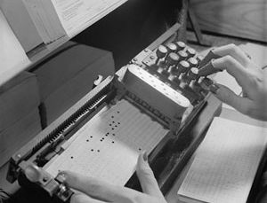
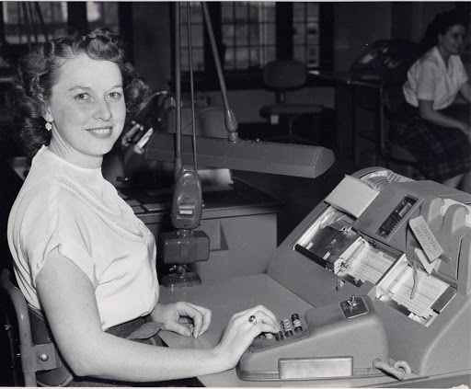

5MBs of data in 1966
Punched cards
62,500 punched cards four days to load
How to write data
IBM Retirees
Notes:
Look back at history. punched card. on the card we have an absence or a presence of holes which represent 0’s and 1’s of digital data. 5MB now = a HD photo.

Slide 6
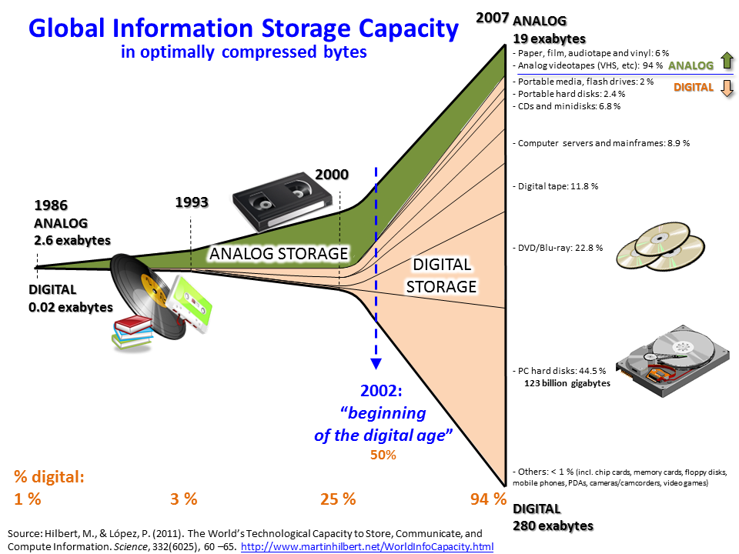
Digital evolution
Notes:
Digital evolution - more data - bigger and bigger. Example of analog and digital data.
2002: 50-50 -> digital age. Now: about 99% of data are digital

Slide 7
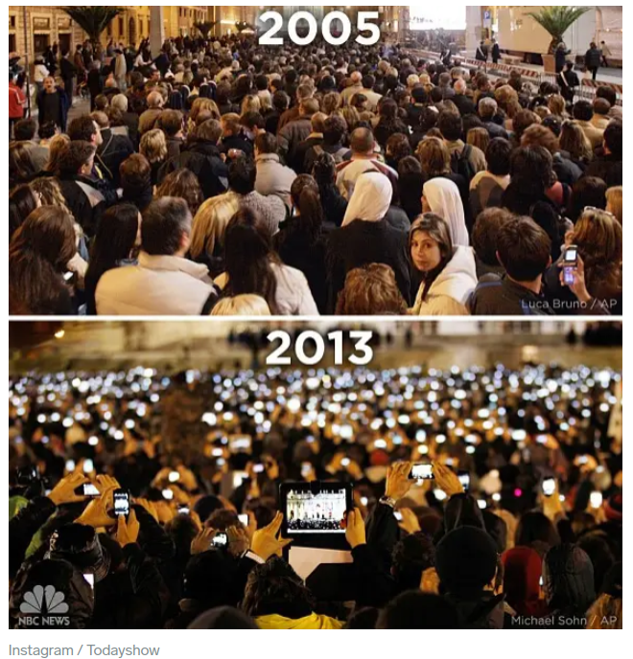

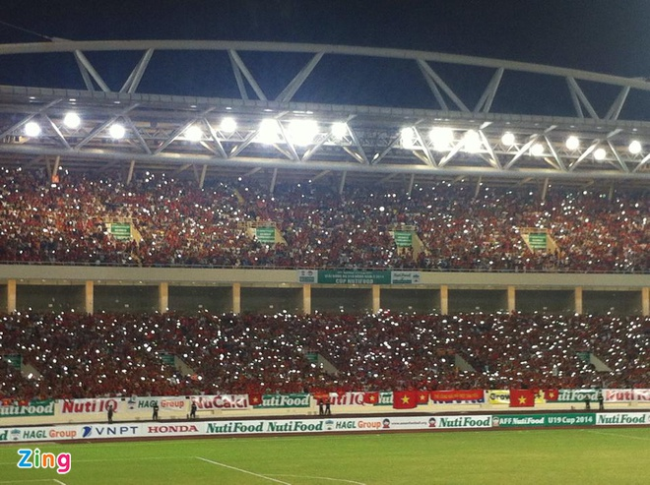
Digital evolution
1998
2018
personal devices
people record social activities
Vantican
Hanoi
Notes:
Not only data storage but personal device evolution. Having a digital camera doesn’t help big data a lot. People use personal devices to record social actitivies. More material to study.

Slide 8

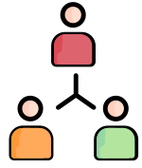


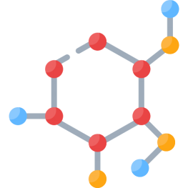

Social science is complex
Particle Molecule
Socio-technological system
Atom
Cell
Human
Social system
flaticon
Notes:
Open question - Most complex - A lot of variables - Unreliable results (20%) -> Computational method can help (up to 80-90%)

Slide 9
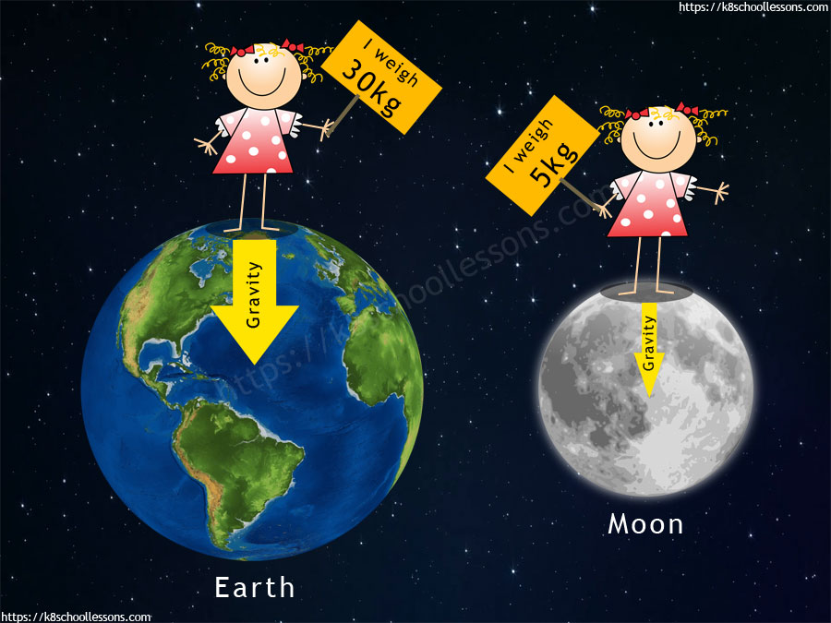


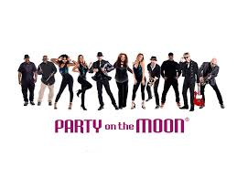
Social science is complex
https://ajc.hcma.vn/ - https://business.facebook.com/partyotm/
Notes:
Open question - Most complex - A lot of variables - Unreliable results (20%) -> Computational method can help (up to 80-90%)

Slide 10
“Big data”
Collection and management of huge quantities of digital data
Using algorithms and dedicated software to automatically analyse such data
Elaboration of statistical models that enable the interpretation of social phenomena and identification of underlying trends
Notes:
Where are the data? A lot of data that it is difficult or impossible to collect and analyse manually. Understaning the socio-technological system will help develop strategies (good for your brand/products/campagnes...)

Slide 11
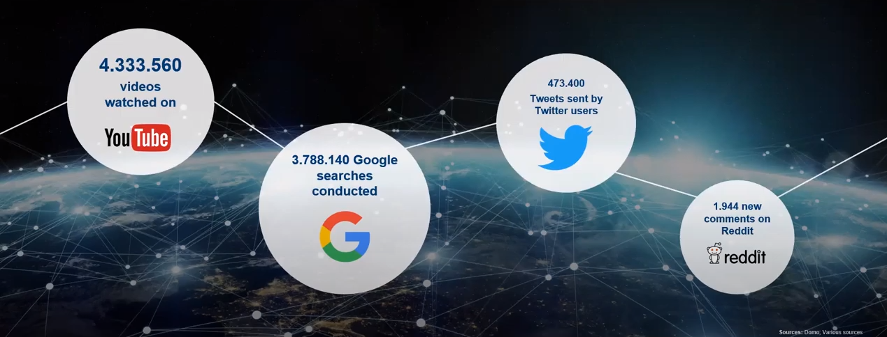

Slide 12

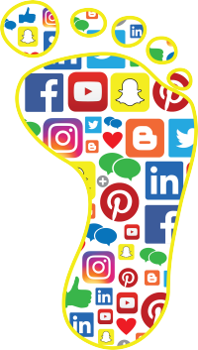
Digital footprint
apps
websites
messages
videos
photos
games
comments
likes
shares
Notes:
Where are the data? Things you left behind on the internet

Slide 13
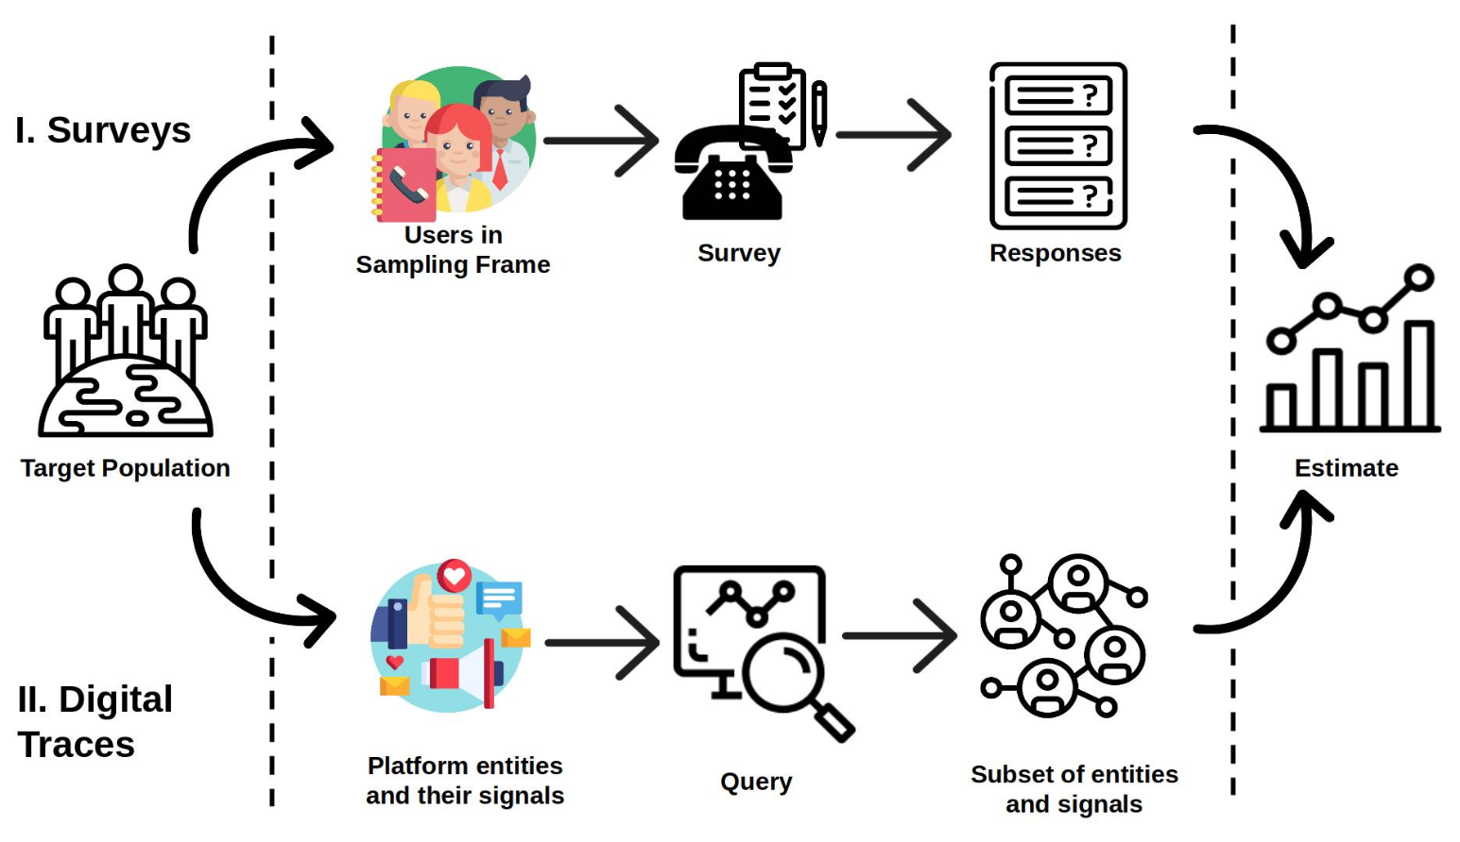
Big data - Computational method
easy and lazy
arxiv.org/abs/1907.08228
Notes:
Easy and lazy - do not need to contact participants/users, survey, call,...

Slide 14
Common research questions
• To what extent can Twitter sentiment predict the outcome of a political election? (Ceron et al. 2013)
To what extent can Twitter data predict political disaffection? (Monti, et al. 2013)

Slide 15
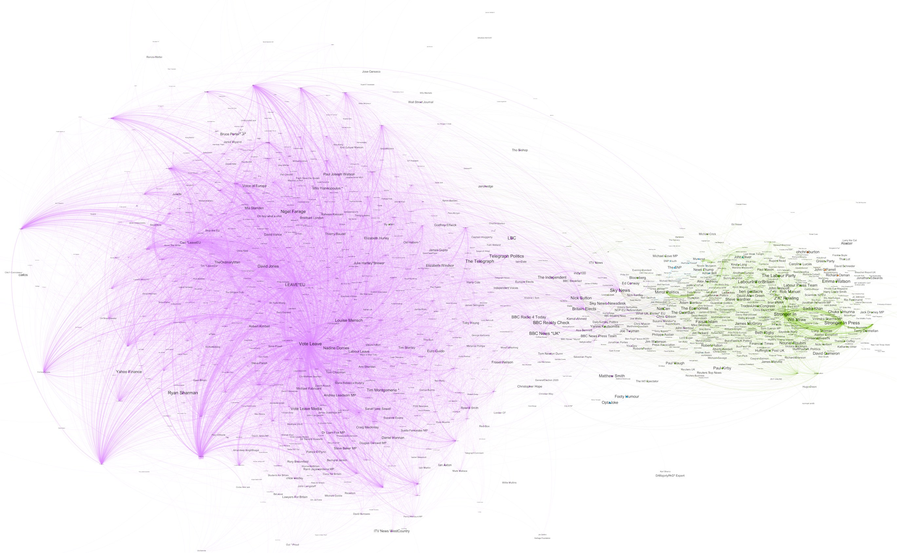


Brexit
Leave group
Remain group
Major established media influencers
Right Relevance, Irish Times

Slide 16
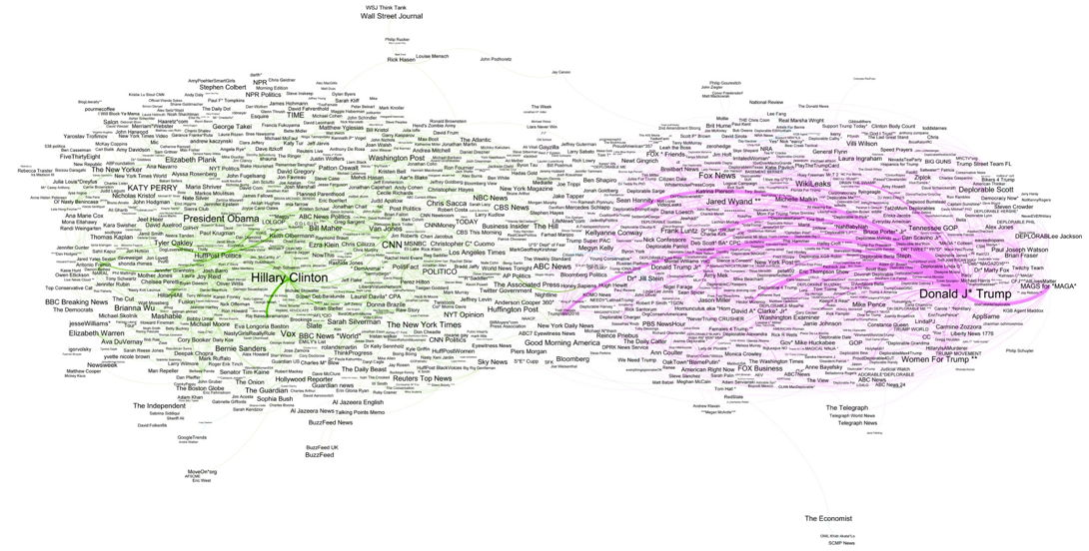
2016 US Election
Major established media influencers
Right Relevance

Slide 17
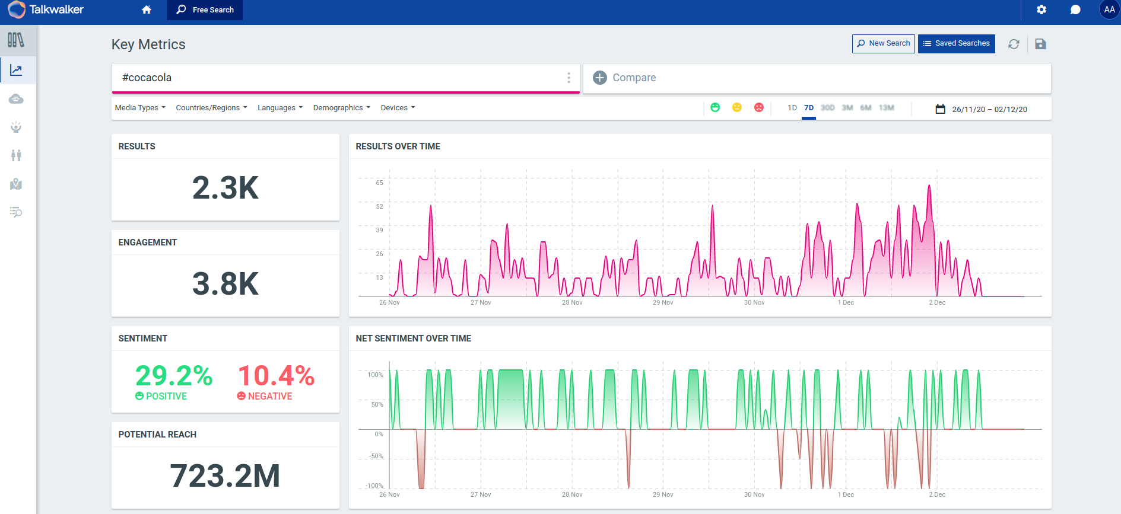
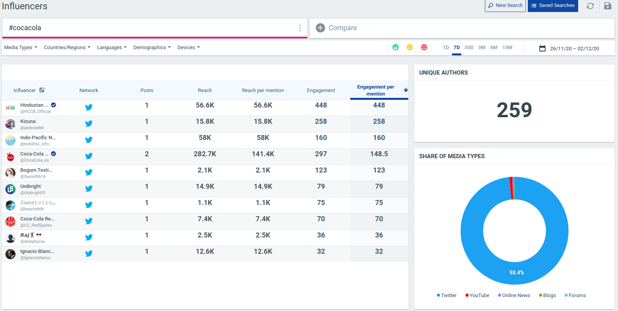
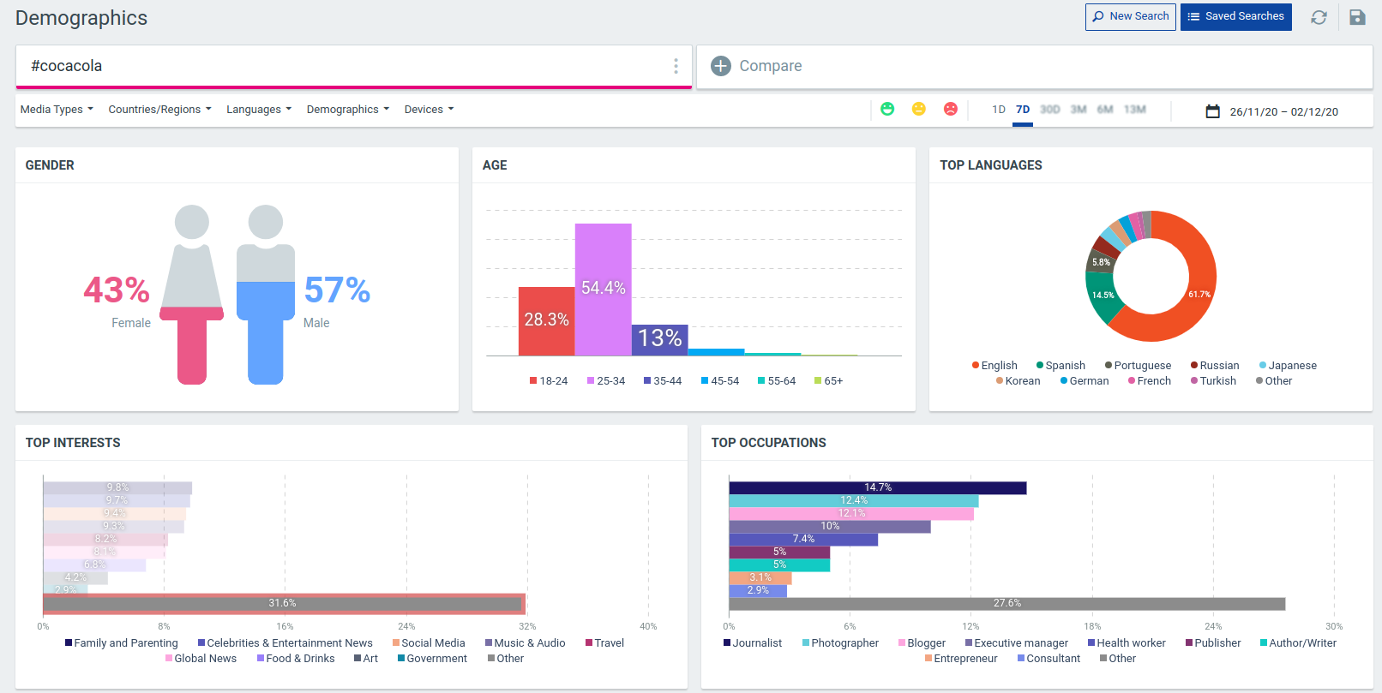
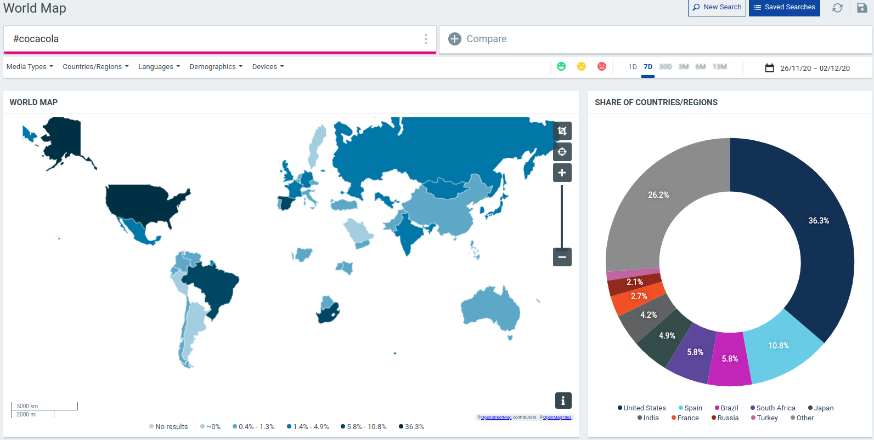
Track hashtags

Slide 18
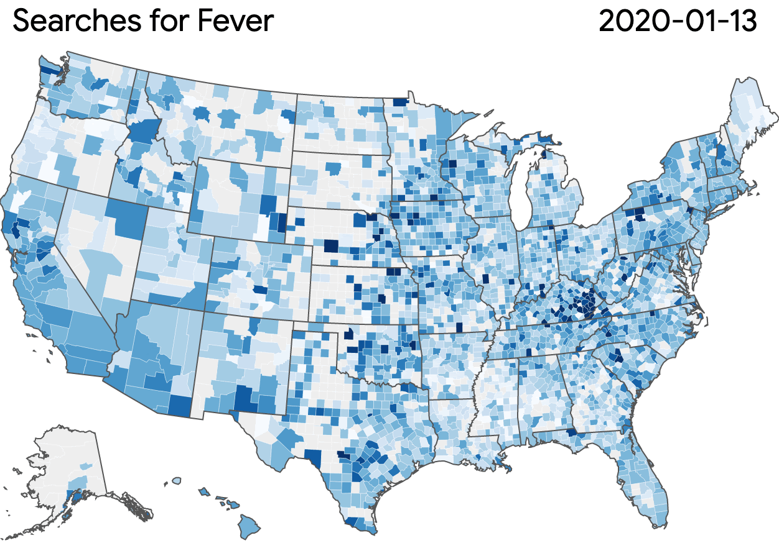

Google trends: coronavirus
https://pair-code.github.io/covid19_symptom_dataset/?date=2020-02-17&symptom=fever

Slide 19
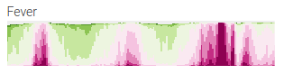
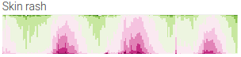

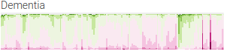


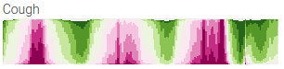
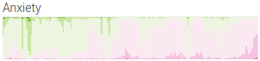
Google trends: coronavirus
2018
2019
2020
2018
2019
2020
https://pair-code.github.io/covid19_symptom_dataset/?date=2020-02-17&symptom=fever

Slide 20
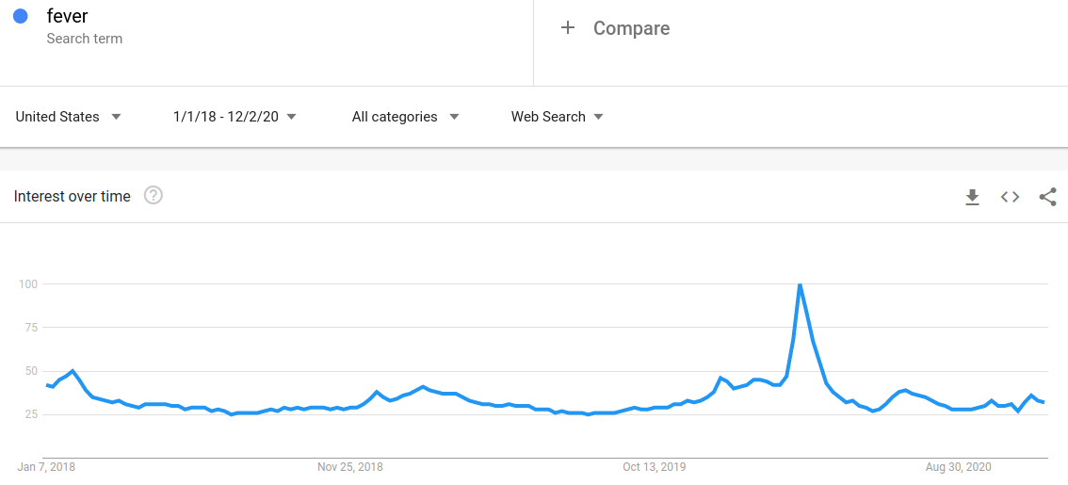
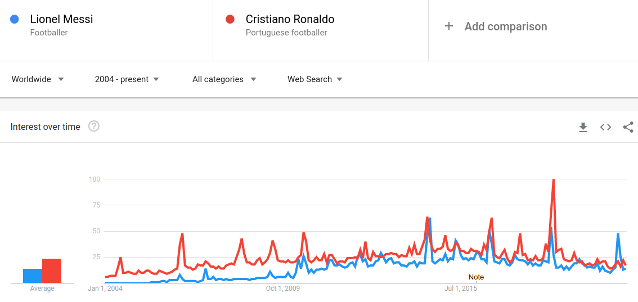
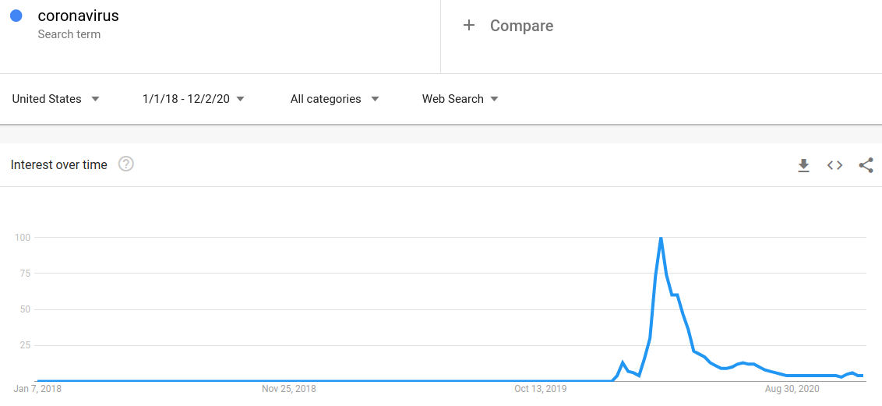
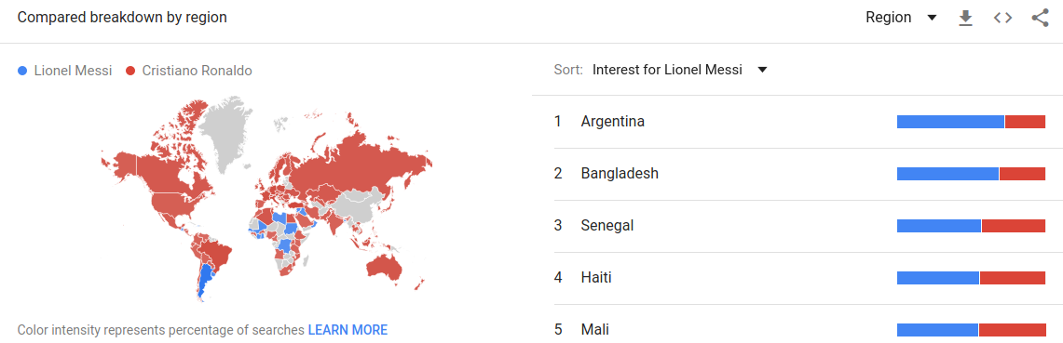
Google trends
https://trends.google.com/trends/explore?date=all&q=%2Fm%2F06qjgc,%2Fm%2F02xt6q

Slide 21
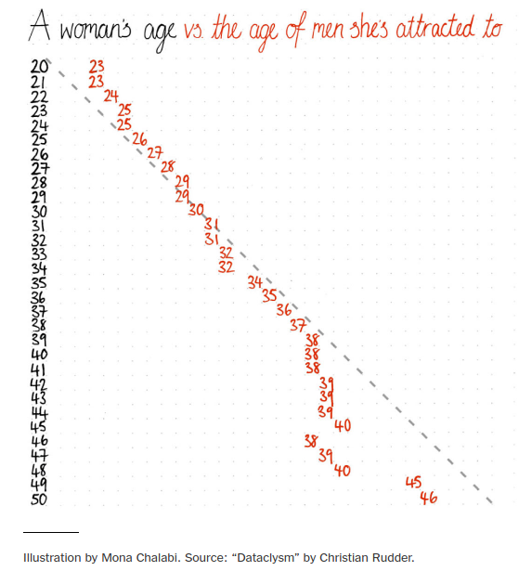
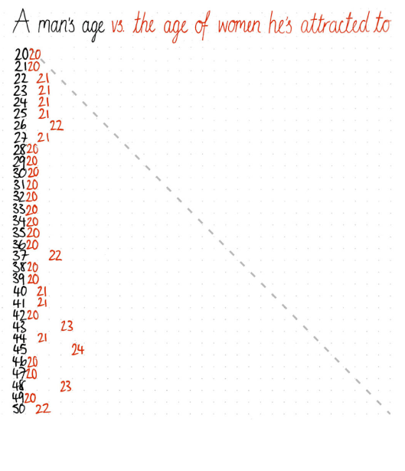
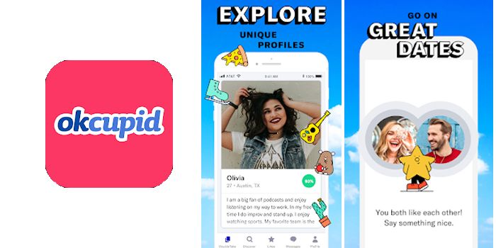
Okcupid
https://www.nytimes.com/2017/09/29/opinion/sunday/dating-age-gap.html

Slide 22
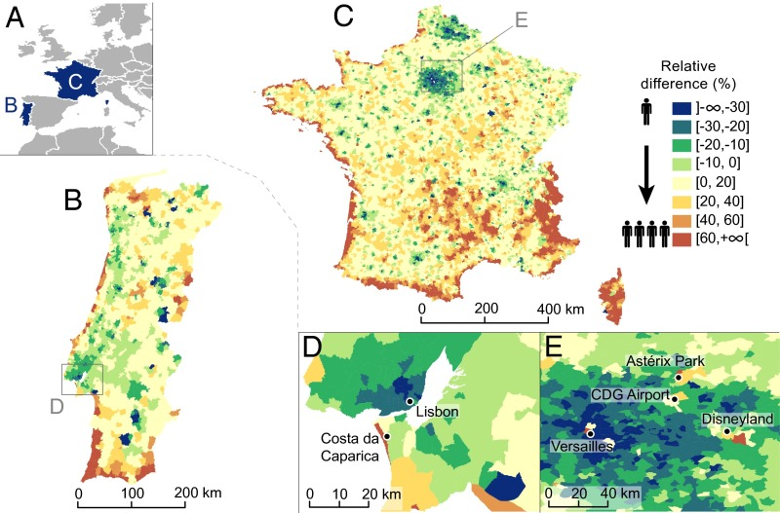
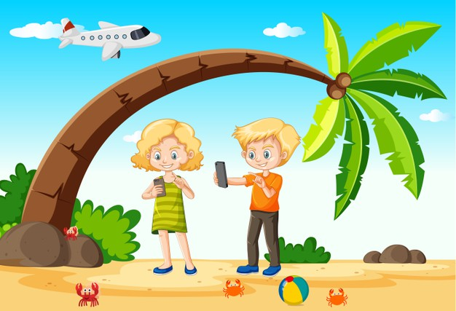
Seasonal changes in population distribution
based on Call Detail Record (CDR) data in summer
less calls
Portugal
France
more calls
Deville et al. (2014)
Notes:
People move from cities to the coastal areas in summer based on call detel record.

Slide 23
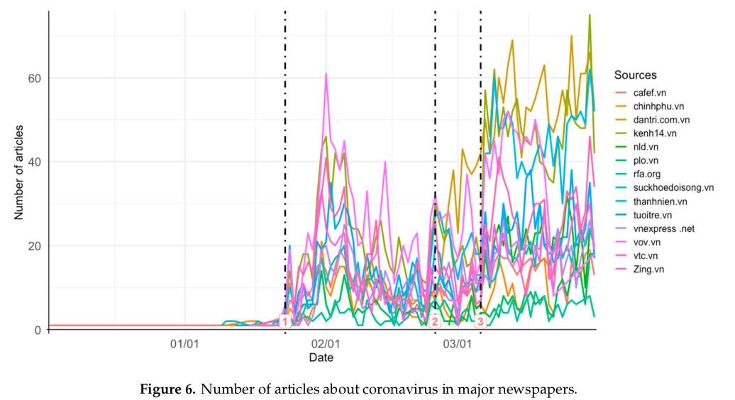
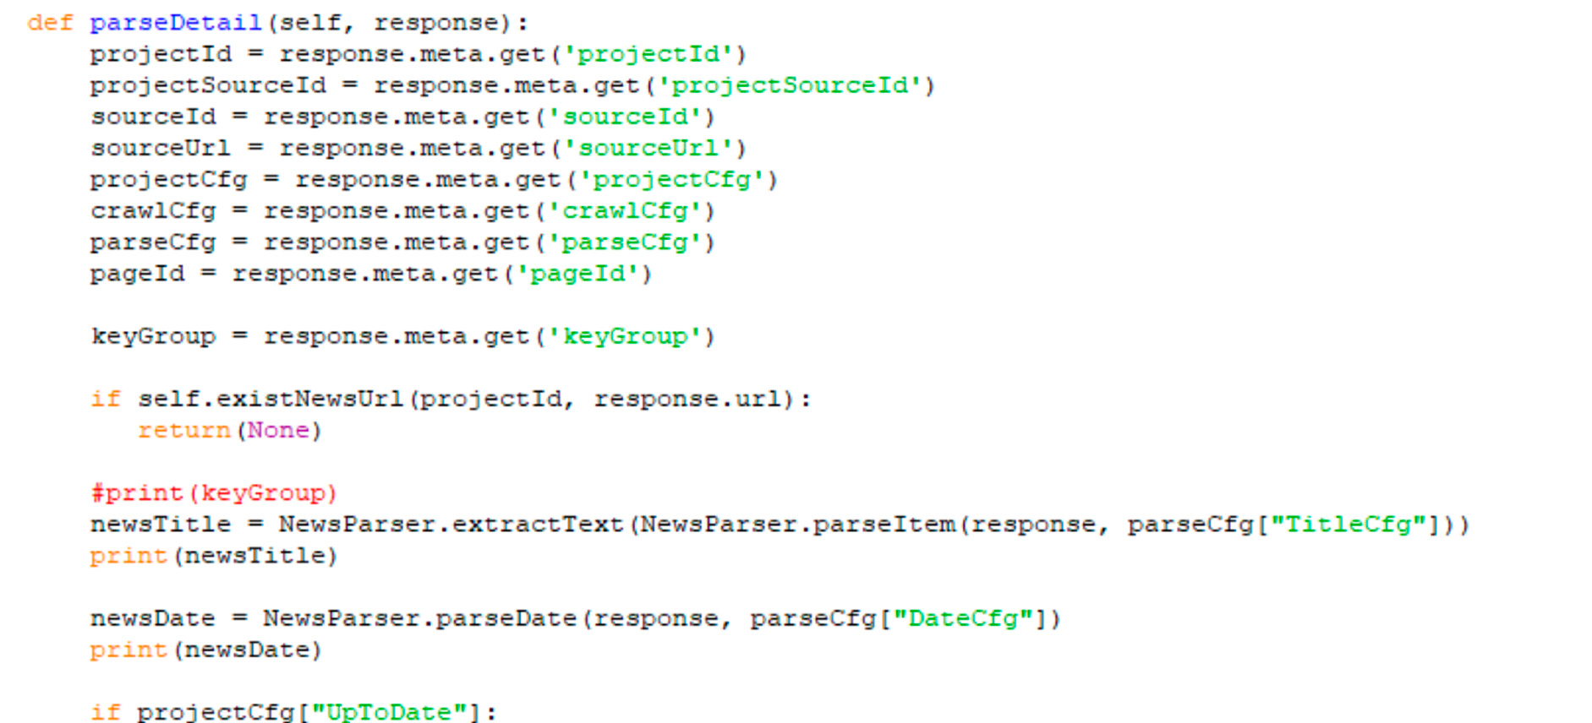
Articles in Vietnamese about coronavirus
A computer program to automatically collect data from major newspapers
La et al. (2020)

Slide 24
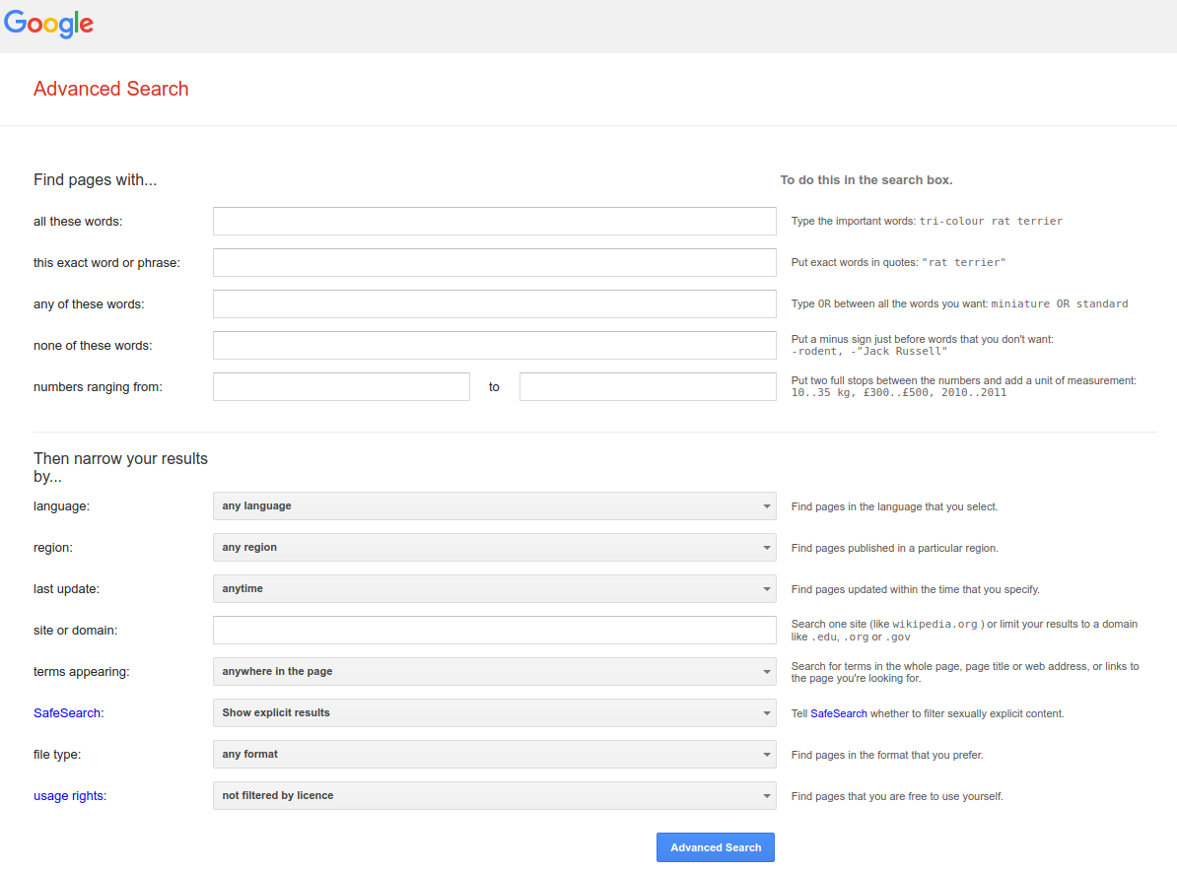
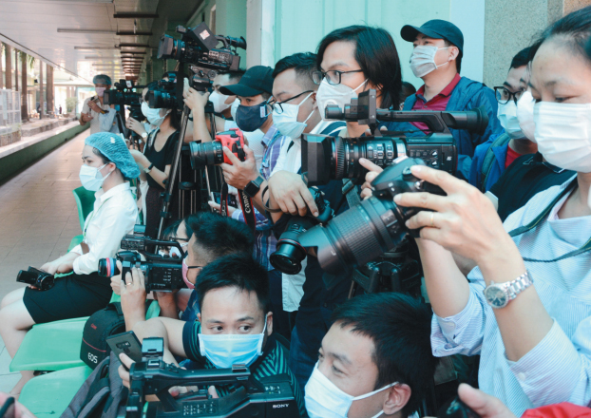
Articles in Vietnamese about coronavirus
VnExpress, Vietnamnet, Tuổi Trẻ
Jan-Mar 2020
3412 articles. mainly in March 2020
Analysis:
685 selected articles
- 238: Covid updates
- 317: Government response
- others
124/685 (59.9%): active role of the media
Dinh Thi Thuy Hang and Nguyen Thi Minh Hien - nguoilambao

Slide 25
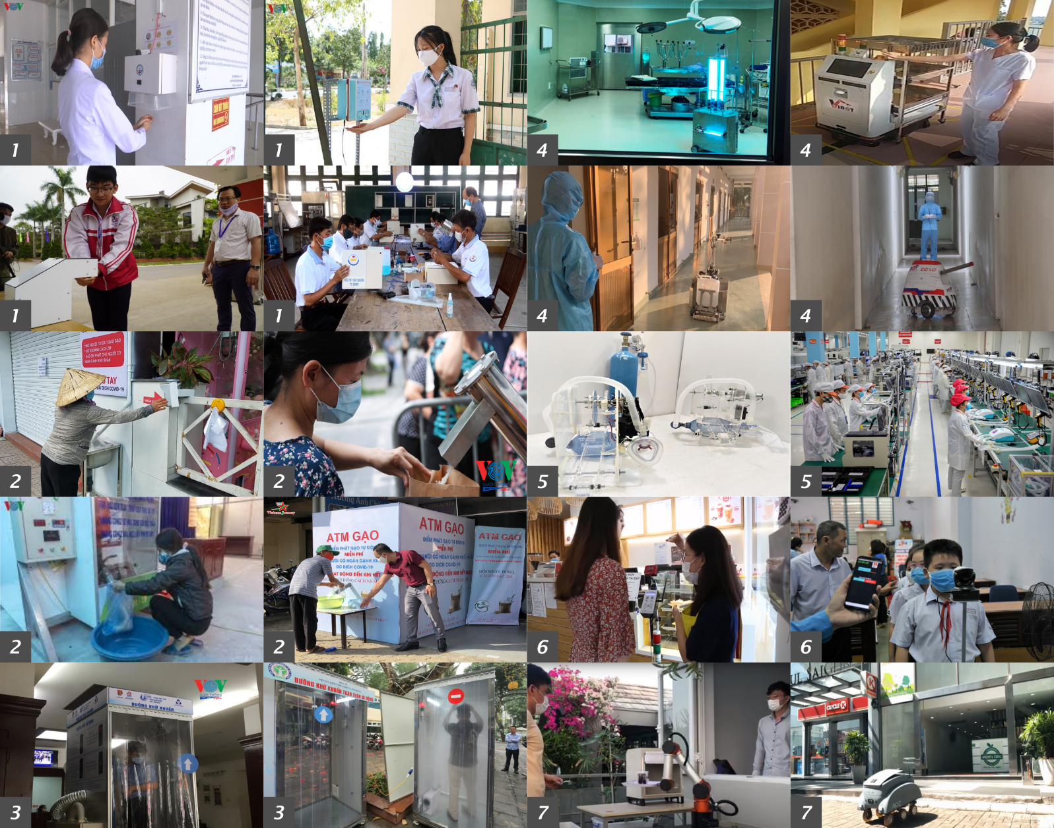

Mixed sources - COVID devices in Vietnam
Google, surveys
https://hoanglongcao.github.io/blog/2020/11/20/media-role-automation-solution-covid-vietnam.html
Cao et al. (2020)

Slide 26
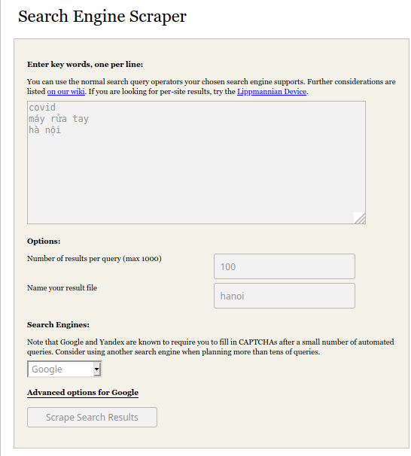
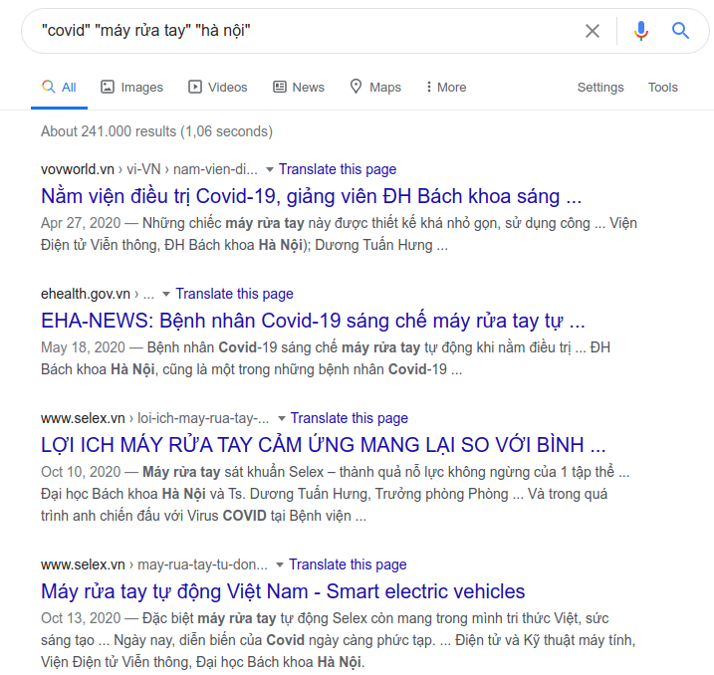
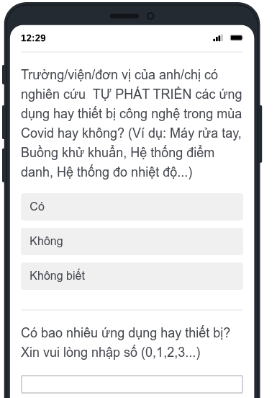
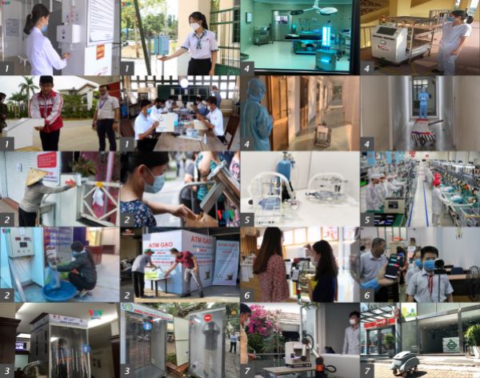
Mixed sources - COVID devices in Vietnam
Google, surveys
Cao et al. (2020)

Slide 27
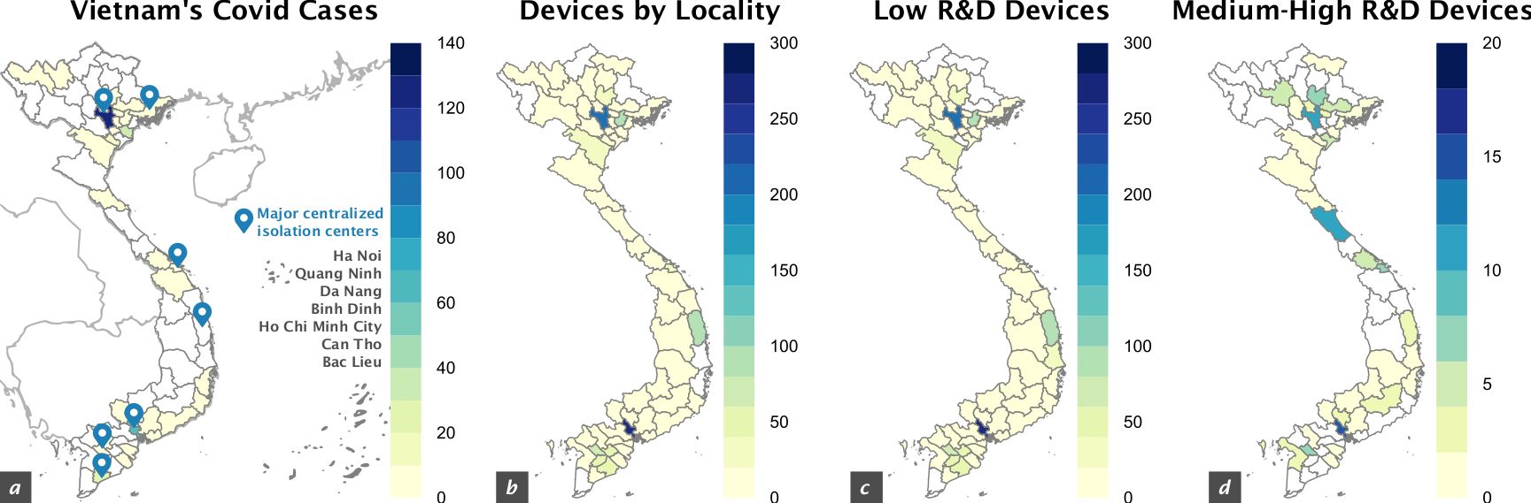
Mixed sources - COVID devices in Vietnam
Google, surveys
total
“low-tech”
“high-tech”
Cao et al. (2020)

Slide 28
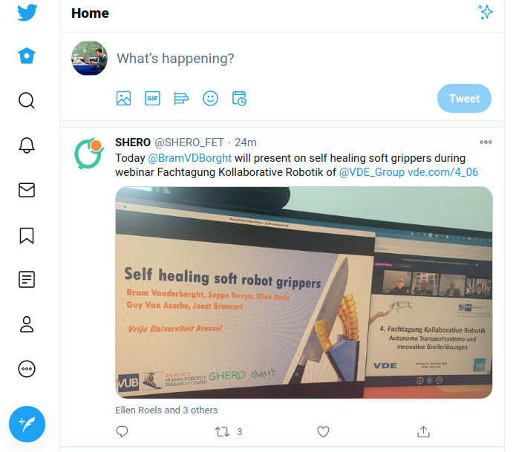
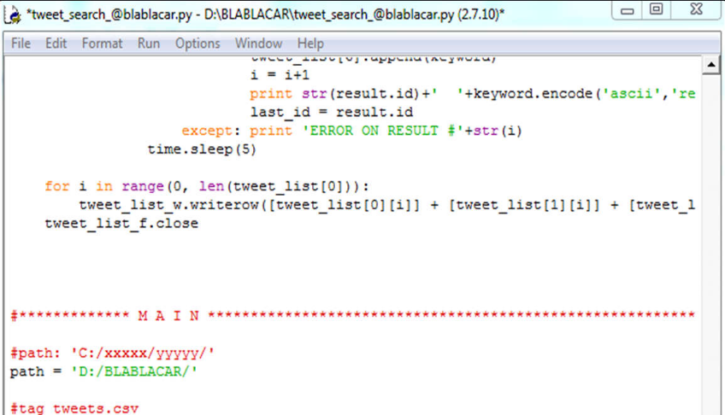

How to collect digital footprint?
Researchers can obtain data through the APIs provided by most social media services in order to retrieve the data stored in the company’s databases
Coding!
GUI = Graphical User Interface API = Application Programming Interfaces
Notes:
When you need to collect a huge amount of data, you can’t do it by the user interface. You need a mechanism to collect data automatically.

Slide 29



How to collect digital footprint?
GUI = Graphical User Interface
API = Application Programming Interfaces
https://medium.com/epfl-extension-school/an-illustrated-introduction-to-apis-10f8000313b9
Notes:
GUI vs API

Slide 30



How to collect digital footprint?
https://medium.com/epfl-extension-school/an-illustrated-introduction-to-apis-10f8000313b9
Notes:
API avoids chaos when many entities try to access data at high frequencies. We will go into detail how to collect digital footprint by using digital tools in the next lecture.

Slide 31

Good morning tweets (Live map)
http://wakingandsleeping-globe.glitch.me/
Notes:
Live Demo

Slide 32

Good morning tweets (Offline render)
early morning
9am
late morning
https://vimeo.com/6239027
Notes:
Live Demo

Slide 33

Good morning tweets (Coding)
Dataset: https://www.kaggle.com/tentotheminus9/good-morning-tweets
Notes:
Live Demo

Slide 34
How to analyse digital footprint?
• Available tools/algorithms
• Develop new tools/algorithms
Notes:
A huge amount of collected data that needs to be analyzed

Slide 35

Okcupid
Age | 20 | 21 | 22 | 23
20 | 40% | 10% | 10% | 5%
21 | 35% | 10% | 10% | 5%
22 | 10% | 30% | 10% | 5%
23 | 10% | 25% | 10% | 5%
*not real data, for demo
https://www.nytimes.com/2017/09/29/opinion/sunday/dating-age-gap.html
Notes:
Visualized data or data like table. Using simple rules and tools e.g. Excel and its functions

Slide 36


Article and Sentiment
Data collected using APIs
Which one is positive/nagative/neutral?
Using Google’s Sentiment Analysis tool
Garvey, C., & Maskal, C. (2019)
Notes:
Using simple rules and tools e.g. Excel and its functions

Slide 37

Article and Sentiment
Machine learning
What if the articles are in Vietnamese?
Data sample
manual coding
Pos.
Neg.
Neu.
Neu.
Training a model
time!
Prediction
automatic
analysis
not limited to text but also images, audios and videos
Notes:
Building new algorithm.

Slide 38


Try it yourself! https://teachablemachine.withgoogle.com/train/image
https://youtu.be/DFBbSTvtpy4
https://youtu.be/CO67EQ0ZWgA
https://teachablemachine.withgoogle.com/train/image
Notes:
Building new algorithm.

Slide 39
Constrains, Drawbacks and Challenges

Slide 40

The Numbers Speak for
Themselves ... well, not quite
The Numbers Speak for Themselves … well, not quite
Big Data are always subjected to manual and human activities:
Cleaning
Navigating
Coding
Notes:
Human is to blame

Slide 41



Cleaning
Cleaning
Many of digital data are produced by Bots. Usually you have to clean them from your data set
Notes:
Filter out irrelevant data. Different people use different cleaning criteria, methods, and tools.

Slide 42


Navigating
Navigating
Notes:
Selecting sources, tools, filter criteria,... A lot of selections to be made.

Slide 43
Mixed sources - COVID devices in Vietnam
Google, surveys
Which survey platforms?
Which universities or organizations?
Which search engine?
Which newspapers?
Cao et al. (2020)

Slide 44
Articles in Vietnamese about coronavirus
A computer program to automatically collect data from major newspapers
Which
newspapers?
La et al. (2020)

Slide 45


Coding
Coding
How to code a text for statistical purposes?
Notes:
Assigning tags and labels strongly influences results.

Slide 46
Mixed sources - COVID devices in Vietnam
Google, surveys
Which one is low-tech?
Which one is high-tech?
“low-tech”
“high-tech”
Cao et al. (2020)
Notes:
Using a different coding for low-tech and high-tech might result in a different map

Slide 47
Biases and ethical issues in big data research

Slide 48


Slide 49
The main ethical issue in digital research
The mere fact that digital data are accessible does not imply that you can take them and use at your please!
(Boyd and Crawford, 2012)

Slide 50

Ethics – Actual Use of Big Data
Actual Use of Big Data

Slide 51









Is it possible to anonymise a tweet?
It is possible to anonymise a tweet?
2
1
4
3

Slide 52
Is it possible to anonymise a tweet?
The recommendations of the Association of Internet Research
on ethical decision-making (Markham & Buchanan, 2012).
When presenting, analysing or discussing data, we use only
public information.
Fuchs (2017) suggests that different codes of ethics consider information public if its producers, e.g. users, cannot reasonably expect to remain unobserved.
The regulation of the studied platforms, e.g. Facebook Data Policy (Facebook, 2016), normally defines such information as any information open to anyone.

Slide 53
Issue-centered digital research
Issue-centered digital research
On one hand, we cannot simply claim that social researchers are fully entitled to access all digital data because those are public and publicly released by users (as it happens for social media) – this argument could work from a legal point of view, but not from an ethical one
On the other hand, we cannot simply renounce the use of such huge amounts of data that may represent invaluable sources of new knowledge about societal issues – thus effectively leaving the management and analysis of such data exclusively in the hands of private companies (Caliandro, Gandini 2017: 48)

Slide 54


Is it possible to anonymise a tweet?
It is possible to anonymise a tweet?
Yes sure, I can delete personal metadata …

Slide 55
The main ethical issue in digital research
The main ethical issue in digital research
It is crucial that subjects of research read, understand, agree and sign an Informed Consent.
But: It becomes unfeasible, extremely time consuming and quite irrational to submit an informed consent to thousands of Twitter users
It is not possible to treat these data anonymously in a proper way (Caliandro, Gandini 2017: 48)
In fact, even if a researcher publishes a Twit with personal information such as usernames and time stamps deleted, it is always possible to retrieve the original message by googling the text of the message itself (Lewis et al., 2008).

Slide 56
Exercise
Client Social
Media Profile & Engagement Analysis
Prepare your computers
Discuss in your teams a brand or a campaign you would like to choose for your Big Data analysis (e.g. asos, gymshark, Ferrari, metoo);
Check the hashtags that these brands are using on Intagram (e.g.#asos, #gymshark). Ensure that there is a substantial number of posts with this hashtag;
Choose one hashtag for analysis and post it one Padlet under your team thread. In the body of your Padlet post, mention the names of people in your team

Slide 57

Lecture 2
relevantinsights.com

Slide 58

Lecture 3
freepik

